Slide 1
WADF105 · GROUP- TEAM-04
TCP/IP Communication in Action:
Opening a Secure Website
FCDF-COHORT-11 · Level 1 Semester 1 · 30 Sept 2026
Presented by
Abdulmalik Isah Gaya C11/26/FCDF17171
Lelah Naomie C11/26/FCDF17134
on behalf of TEAM-04
Notes:
Introduce the scenario: one secure page load looks simple to the user, but it activates every TCP/IP layer from DNS through HTTPS.

Slide 2
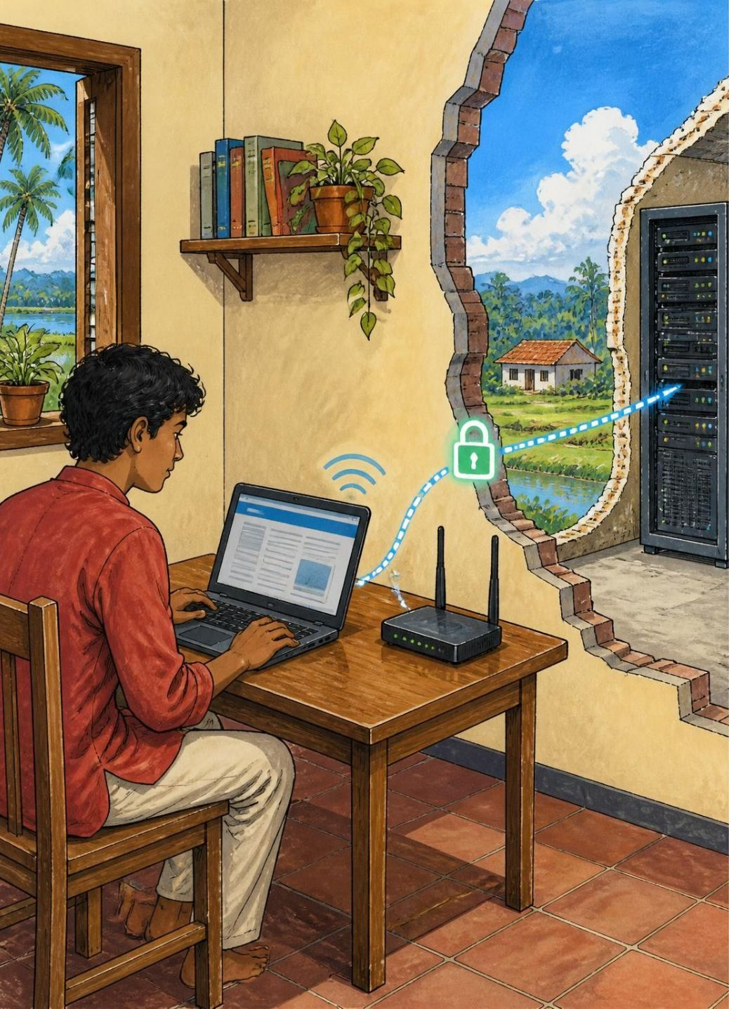
THE SCENARIO
One page load touches every layer of the stack
A user opens https://example.com on a laptop.
Trace the packet from client to web server and back.
It covers DNS, TCP, TLS, HTTP, IP, MAC, ports, and security.
Devices: client laptop, access point/switch, router, internet, firewall, web server.
A single page load activates the complete stack
2
Notes:
Set the route before discussing protocols. The rest of the deck follows this one request from the laptop to the web server and back.

Slide 3
The TCP/IP model has four layers, and each adds its own header
Application · Data = message
1
Services to the user. HTTP, DNS, TLS.
Transport · Data = segment
2
End-to-end delivery, ports, reliability. TCP, UDP.
Internet · Data = packet
3
Logical addressing and routing. IP.
Network Access · Data = frame
4
Physical transmission on the local link. Ethernet, Wi-Fi, ARP.
Key principle: each layer adds its own header, called encapsulation.
3
Notes:
Read downward. The PDU changes as each lower layer adds the information it needs to move the request.

Slide 4
TCP/IP folds OSI's top three layers into one Application layer
OSI model (7 layers) | TCP/IP (4 layers) | Purpose
7 Application, 6 Presentation, 5 Session | Application | HTTP, DNS, TLS, encryption, session
4 Transport | Transport | TCP port numbers, reliability
3 Network | Internet | IP addressing and routing
2 Data Link, 1 Physical | Network Access | MAC addressing, Wi-Fi/Ethernet frames
4
Notes:
The important mapping is at the top: OSI separates application, presentation and session; TCP/IP treats them together as Application.

Slide 5
Four kinds of address get a packet from laptop to server
IP address
MAC address
192.168.1.10 → 93.184.216.34
aa:bb:cc:11:22:33 → router MAC
Routes across networks; changes only at NAT.
Local delivery; changes every hop.
Port numbers
URL / FQDN
54321 → 443 (HTTPS)
https://example.com
Identifies the application process; netstat -an shows it.
Resolved by DNS before the connection begins.
5
Notes:
Contrast the scopes: URL is the human name, DNS finds the IP, IP routes between networks, MAC delivers locally, and ports select the process.

Slide 6





PACKET JOURNEY
The request travels right, the response comes back left
Client laptop
Router
Encapsulation: HTTPS request starts
Routes packet toward internet
Access Point
Internet
Wireless or switch relay
Transit across networks
Direction
Request: client → server · Response: server → client
6
Notes:
Give this slide room. The request crosses local access, routing, the internet and firewall controls before the web server unwraps it. The response returns along the reverse path.

